Slide 1

Java Collections
List Interface
Array and Linked
Java Generics
Interface Decisions
Objects
Notes:
The Java collections library is a great example of an OO framework. We’ll see how it works in this lesson.
We’ll look at the list interface and two implementations: the arraylist and the linked list.
Look at Java generics and C++ templates in the next lesson
Discuss some decisions made on the list interface and compare to how python decided.

Slide 2

See Also
https://www.geeksforgeeks.org/collections-in-java-2/
https://www.w3schools.com/python/python_lists.asp
https://en.wikipedia.org/wiki/Collection_(abstract_data_type)
Notes:
Here is some additional reading for you on the web.

Slide 3


List Interface
List names = ???
names.add("World");
names.add(0,"Hello");
System.out.println(names.get(0));
System.out.println(names.get(1));
System.out.println("There are "+names.size()+" items.");
List
Java
add(object) : boolean
add(index, object) : void
remove(index) : Object
clear() : void
contains(object) : boolean
indexOf(object) : int
get(index) : Object
set(index, object) : Object
size() : int
isEmpty() : boolean
Hello
World
There are 2 items.
Notes:
what are collections – can grow and shrink
“add” return “true” if the list was modified (some might reject duplicates or nulls, for instance) overloads
Java OO collections (different from the C++ STL … next lesson)
Hold pointers to objects
List interface
Different implementations – different kinds of lists – they all look the same from the interface We know how to use the all because same interface
Talk through the interface … isEmpty compared to size() == 0
Before you object, we will get to generics later in this lesson

Slide 4
Array List
4000
List names = new ArrayList();
names.add("Sam");
names.add("Bob");
names.add("Jan");
System.out.println(names.get(1));
System.out.println(names.get(2));
names.add(1,"Sue");
Java
0010
0150
Bob
0010
0024
0024
Jan
150
Sam
Fast with random access (gets, sets)
Notes:
Fast random access
Slower inserts
Pseudo code for get/set and add
Big O?

Slide 5
Array List
4000
List names = new ArrayList();
names.add("Sam");
names.add("Bob");
names.add("Jan");
System.out.println(names.get(1));
System.out.println(names.get(2));
names.add(1,"Sue");
Java
0010
0150
Bob
0200
0024
0010
Jan
0024
150
Sam
200
Sue
Fast with random access (gets, sets)
Slow with inserts/deletes

Slide 6
Linked List
4000
next
value
List names = new LinkedList();
names.add("Sam");
Java
0000
0150
150
Sam
Notes:
Fast inserts/deletes
Pseudo code again Big O

Slide 7
Linked List
4000
next
value
List names = new LinkedList();
names.add("Sam");
names.add("Bob");
Java
4100
0150
0010
Bob
4100
next
value
0000
0010
150
Sam
Notes:
Fast inserts/deletes
Pseudo code again Big O

Slide 8
Linked List
4000
next
value
List names = new LinkedList();
names.add("Sam");
names.add("Bob");
names.add("Jan");
System.out.println(names.get(1));
System.out.println(names.get(2));
names.add(1,"Sue");
Java
4100
0150
0010
Bob
4100
next
value
4200
0010
0024
Jan
4200
next
value
150
0000
0024
Sam
Notes:
Fast inserts/deletes
Pseudo code again Big O

Slide 9
Linked List
4000
next
value
List names = new LinkedList();
names.add("Sam");
names.add("Bob");
names.add("Jan");
System.out.println(names.get(1));
System.out.println(names.get(2));
names.add(1,"Sue");
Java
4300
0150
0010
Bob
4100
next
value
4200
0010
0024
Jan
4200
next
value
150
0000
0024
Sam
200
4300
next
value
Sue
Slow random access (gets, sets)
Fast inserts/deletes
4100
0200
Notes:
Fast inserts/deletes
Pseudo code again Big O

Slide 10
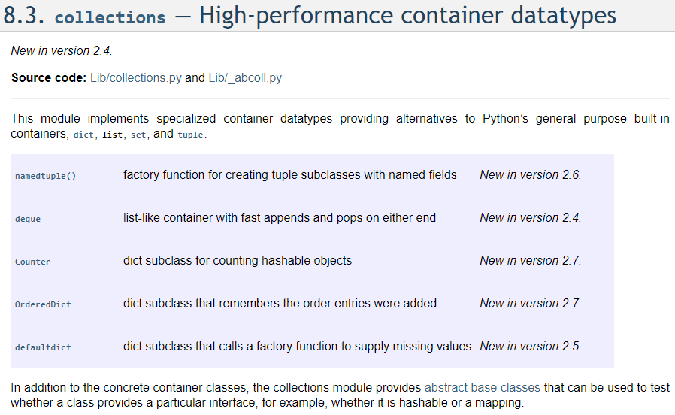
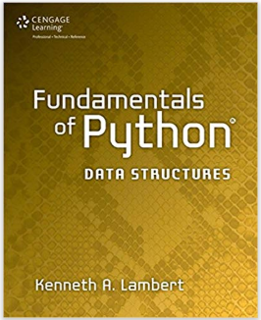
Python Linked List
https://www.amazon.com/Fundamentals-Python-Structures-Kenneth-Lambert/dp/1285752007/ref=sr_1_3

Slide 11
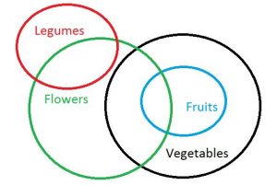
Nasty Downcast
List names = new ArrayList();
names.add("Sam");
names.add("Jan");
String bob = "Bob";
Object o = bob;
names.add(o);
String n = (String) names.get(1);
Java
All Strings are Objects (Object is the baseclass of everything)
Upcasting is automatic and guaranteed to work
Not all Objects are Strings
Downcasting must be explicit and might fail
It fails at RUNTIME
Notes:
- At least Java will blowup if you are wrong. C++ continues on (can use better casts and RTTI)

Slide 12
Java Generics
List<String> items = new ArrayList<String>();
// = new LinkedList<String>();
items.add("HELLO");
items.add("WORLD");
String a = items.get(0);
String b = items.get(1);
System.out.println(a);
System.out.println(b);
Java
Compile error if not a String
No cast needed
Notes:
Didn’t have the first check. Could add anything.

Slide 13
Lost at Runtime
public static void plain() {
List items = new ArrayList();
items.add("Hello");
String a = (String) items.get(0);
System.out.println(a);
}
Java
public static void withGenerics() {
List<String> items = new ArrayList<String>();
items.add("HELLO");
String a = items.get(0);
System.out.println(a);
}
Java
public static void plain();
Code:
0: new #2 // class java/util/ArrayList
3: dup
4: invokespecial #3 // Method java/util/ArrayList."<init>":()V
7: astore_0
8: aload_0
9: ldc #4 // String Hello
11: invokeinterface #5, 2 // InterfaceMethod java/util/List.add:(Ljava/lang/Object;)Z
16: pop
17: aload_0
18: iconst_0
19: invokeinterface #6, 2 // InterfaceMethod java/util/List.get:(I)Ljava/lang/Object;
24: checkcast #7 // class java/lang/String
27: astore_1
28: getstatic #8 // Field java/lang/System.out:Ljava/io/PrintStream;
31: aload_1
32: invokevirtual #9 // Method java/io/PrintStream.println:(Ljava/lang/String;)V
35: return
public static void withGenerics();
Code:
0: new #2 // class java/util/ArrayList
3: dup
4: invokespecial #3
7: astore_0
8: aload_0
9: ldc #10
11: invokeinterface #5, 2
16: pop
17: aload_0
18: iconst_0
19: invokeinterface #6, 2
24: checkcast #7
27: astore_1
28: getstatic #8
31: aload_1
32: invokevirtual #9
35: return
Notes:
- Show that the generics is a compiler trick … doesn’t affect the runtime

Slide 14
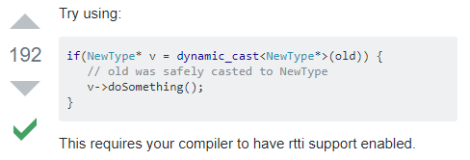
Heterogeneous Collections
var s 'hello'
if(typeof s == 'string') {} // true
t = new String()
if(t instanceof String) {} // true
JavaScript
List items = new ArrayList();
// = new List<Object>();
items.add("hello");
items.add(45);
items.add(new Point(1,2));
Point p = (Point) items.get(2);
int a = (int) items.get(1);
String b = (String) items.get(0);
Object o = items.get(1);
if(o instanceof String) { ... }
Java
s = 'hello'
if type(s) == str:
pass
if isinstance(s, str):
pass
Python
C++
Notes:
Store different kinds of objects
Must have a way to figure out what they really are:
Isinstance
Common base class

Slide 15
Polymorphic
public class Animals {
public static void speak(Animal an) {
an.sayHi();
}
public static void main(String [] args) {
List<Animal> zoo = new ArrayList<Animal>();
Cat cat = new Cat();
Annimal dog = new Dog();
speak(cat);
zoo.add(cat);
zoo.add(dog);
Animal an = zoo.get(0);
an.sayHi();
an = zoo.get(1);
an.sayHi();
}
}
Java
interface Animal {
public void sayHi();
}
class Cat implements Animal {
public void sayHi() {
System.out.println("Meow!");
}
}
class Dog implements Animal {
public void sayHi() {
System.out.println("Woof!");
}
}
Java
Meow!
Meow!
Woof!
Notes:
We will revisit this in C++

Slide 16
Decisions
Java | List (Java) | list (Python) | Python
j.add("hi"); | add(object) : boolean | append(object) | p.append('hi')
j.add(5, "wow"); | add(index, object) : void | insert(index, object) | p.insert(5,'wow')
j.remove(3); | remove(index) : Object | __delitem__(index) | del p[3]
j.clear(); | clear() : void | clear() | p.clear()
if(j.contains("hi")) … | contains(object) : boolean | __contains__(object) | if 'hi' in p:
i = j.indexOf("hi"); | indexOf(object) : int | index(object) | i = p.index('hi')
a = j.get(2); | get(index) : Object | __getitem__(index) | a = p[2]
j.set(2,"new"); | set(index, object) : Object | __setitem__(index, obj) | p[2] = 'new'
s = j.size(); | size() : int | __len__() | s = len(p)
if(j.isEmpty()) … | isEmpty() : boolean |  | if p:
Exception
Uses len == 0

Slide 17

Tinkering
Make one list of 1000 strings and another of 100,000 strings.
Time how long it takes to get the length. Time checking “isEmpty”.
Compare the times in Python and Java.
Notes:
Here are a couple of things to think about and/or try. This is totally optional … nothing for you to send to me.

